Slide 2
Table of contents
Foundation for support of reforms in Ukraine. Initiation……………………….3
Structure of the Foundation …………………………………………………………4
Areas of Activities …………………………………………………….5
Partners of the Foundation …………………………………………………………6
Projects and initiatives ……………………………………………………7
Contacts …………………………………………………21

Slide 3

Foundation for support of reforms in Ukraine. Initiation
January 2015
The Foundation was founded at the discretion of the National Reform Council jointly with the European Bank for Reconstruction and Development, at support of International Renaissance Foundation.
The Foundation is an independent, non-governmental union.
Primary goal is to promote the development of Ukraine and improve the material well-being of its citizens by supporting the development and implementation of reforms in Ukraine.
3

Slide 4

Structure of the Foundation
National Reforms Council
DONORS
MEETING
The supreme governing body
SUPERVISORY BOARD
Supervisory body (statutory and financial activities)
CHIEF ACCOUNTANT
EXECUTIVE DIRECTOR
PROJECTS AND INITIATIVES OF THE FOUNDATION
PROJECT MANAGEMENT OFFICE
(PMO)
INITIATIVE
DIGITAL UKRAINE
PROFESSIONALS FOR REFORM SUPPORT MECHANISM
INITIATIVE
GO GLOBAL (UKRAINE SPEAKING)
REFORMS COMMUNICATION
• • •
4

Slide 5

Areas of Activities
Coordination of the process of development, implementation and monitoring of implementation of reforms
Encouragement of economic growth and economic development of Ukraine and separate regions thereof, as well as increase of the competitiveness of Ukraine
Selection, recruitment and coordination of experts for development and monitoring of implementation of reforms
Improvement of the image of Ukraine abroad
Engagement of the community in the development, monitoring and control of the reforms process
Communication of reforms to domestic and foreign markets
Improvement of civil servants’ professionalism
Attracting of investment into Ukraine
5

Slide 6









Partners of the Foundation
6

Slide 7



Projects and initiatives of the Foundation
PROJECT MANAGEMENT OFFICE
for coordination development and implementation of reforms
REFORMS COMMUNICATION
PROFESSIONALS FOR REFORM SUPPORT MECHANISM
Better Regulation Delivery Office
(BRDO)
Export promotion office
(EPO)
7

Slide 8
Projects and initiatives of the Foundation
Ukraine Conflict Security and Stability Fund
«HUB SCHOOL» Project Office
8

Slide 9
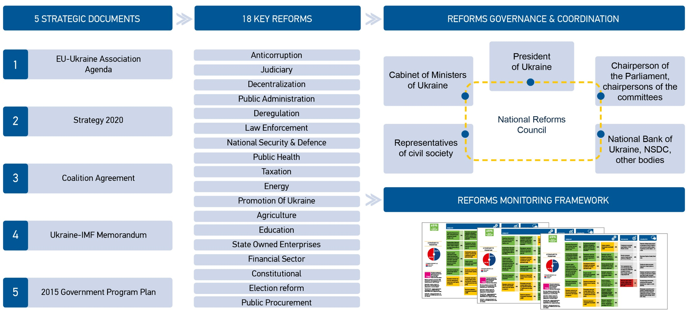
How projects are selected
Ukraine has a vast reforms agenda
9

Slide 10
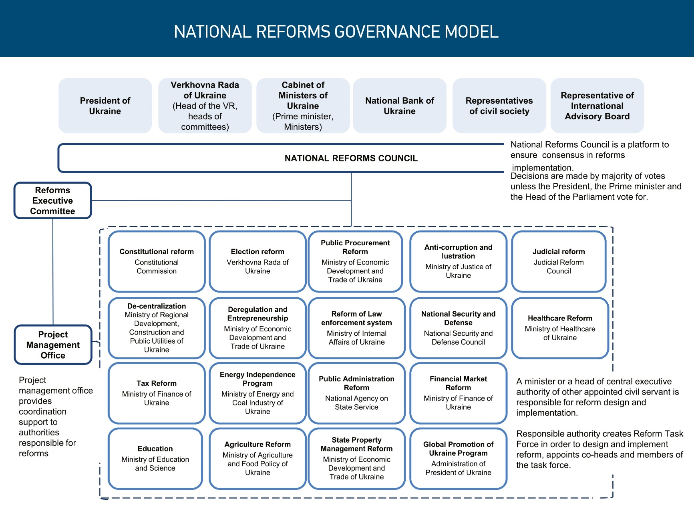
How projects are selected
Tools needed for effective management and coordination of reforms
10

Slide 11
How projects are selected
Needs related to the development, implementation and monitoring of reforms
PROJECTS AND INITIATIVES OF THE FOUNDATION
11

Slide 12
More about the projects and initiatives of the Foundation
12

Slide 13

Project Management Office of the National Reforms Council
Professionals with strong skills in project management, analytics.
Project Management Office performs advisory functions to ensure common standards in the development and planning of reforms and reporting on their implementation
Project Management Office is responsible for coordinating the development and implementation of reforms, monitoring their implementation and providing communication between ministries and Parliament, and between the Government and public sector.
In its work Project Management Office uses EBRD procedures and standards determined by the agreement-memorandum.
13

Slide 14
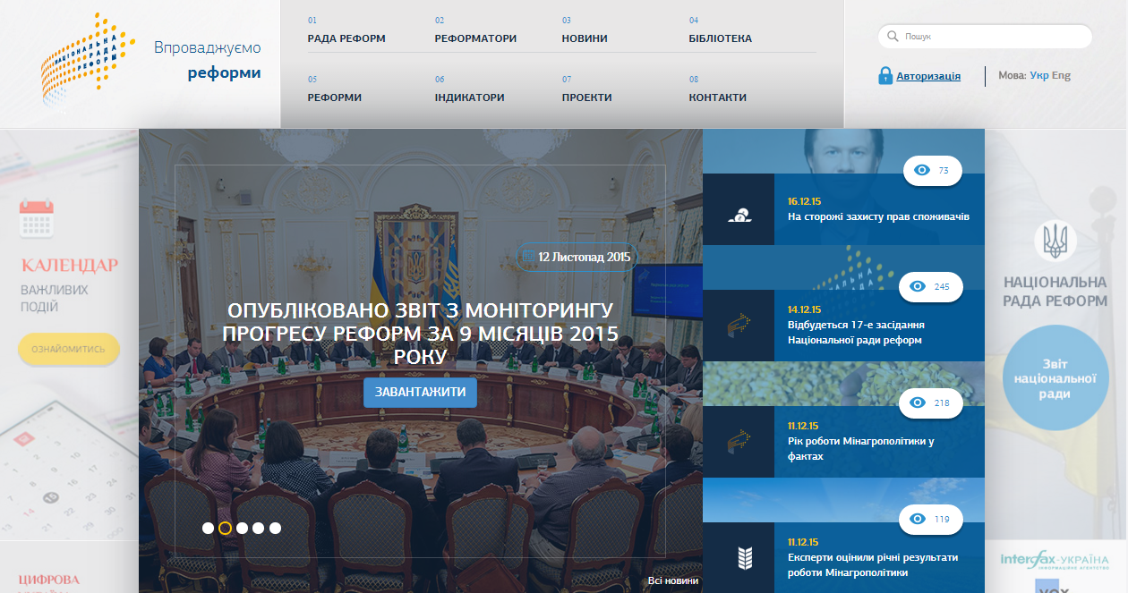
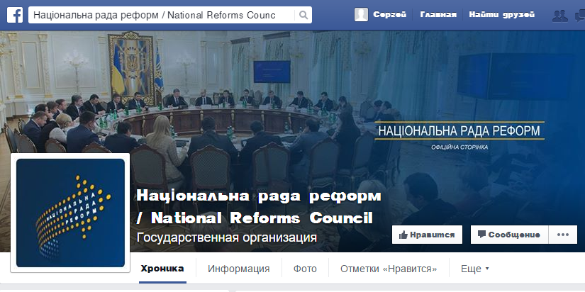
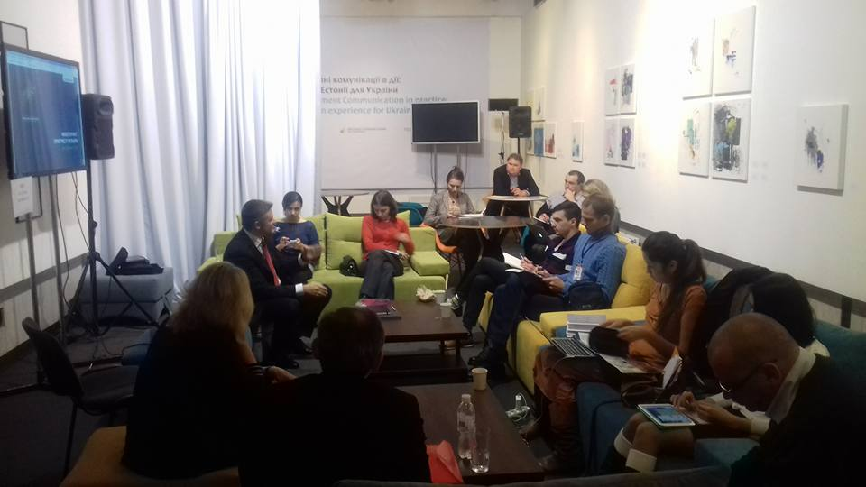
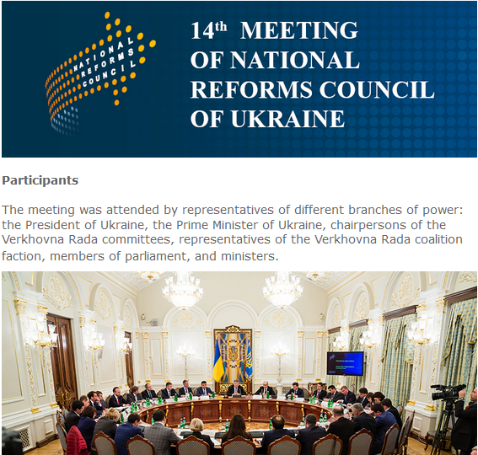

Reforms communication
The goal of the initiative is provide the information support, interpret the reforming process in Ukraine, organize a permanent communication on key reforms in Ukraine implementation.
Web-site of the National Reforms Council
Social media
Press-clubs Off the Record
Reports and Digests
14

Slide 15
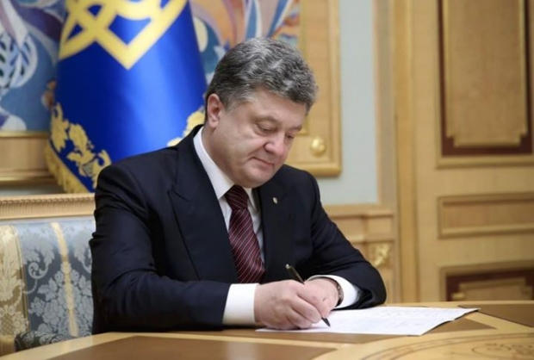
DIGITAL UKRAINE
DIGITAL UKRAINE – AS THE BASIS FOR E-GOVERNANCE DEVELOPMENT
The goal of the initiative is the creation of the legal basis for state-of-the-art IT solutions implementation in public area and digital services provision to citizens and business.
15

Slide 16

Professionals for Reform Support Mechanism
Professionals for Reform Support Mechanism (PRSM)
The Professionals for Reform Support Mechanism provides human resource support to critical reform initiatives undertaken by national governmental agencies.
WHY PRSM? PRSM is a platform for a coordinated response that ensures:
A link to priority reforms and reform oversight – PRSM is under the umbrella of the National Reform Council and responds to priority reform needs.
Transparency – flowing ministerial requests through one window improves donor coordination and avoids overlap of donor funding.
Consistency: requests are managed according to one set of procedures.
Legality: all human resources are contracted according to law and paid via bank transfer.
16

Slide 17

Programs supported by the Foundation
BRDO – The Better Regulation Delivery Office
BRDO is a non-governmental independent entity that works in collaboration with business, various agencies, and ministries to tackle issues of regulatory environment in order to eliminate barriers for business and boost economic growth of Ukraine. The BRDO conducts a review of all state regulations in selected industries for effective regulation.
The ultimate goal of the creation and functioning of the BRDO is to reduce the cost and complexity of doing business, reduce corruption factors and build capacity for better regulation.
17

Slide 18

Programs supported by the Foundation
EPO – The Export promotion office
The EPO will assist the Ministry of Economic Development and Trade and Deputy Minister/Trade Representative and will provide services to Ukrainian businesses, both existing and potential exporters in facilitating effective communication between government and business.
The goal of the EPO project is to increase export, assist Ukrainian companies in accessing new markets, expand presence on existing markets, and promote Ukrainian products and brands.
18

Slide 19

GO GLOBAL
GO GLOBAL: NATIONAL FOREIGN LANGUAGE LEARNING AND PROMOTION INITIATIVE
Foreign languages ​​learning was defined as a national policy priority in the strategic documents of the EU and Ukraine.
A joint initiative of civil activists, government, international and domestic partners.
19

Slide 20

Ukraine Conflict Security and Stability Fund
In April 2016 the non-governmental union "Foundation for Support of Reforms in Ukraine" and Ministry of Defense of Ukraine have signed a Memorandum of partnership and cooperation.
The purpose of the Memorandum is to consolidate efforts aimed at identifying a common vision on the reforms concept in the Ministry of Defense of Ukraine and the General Staff of the Armed Forces of Ukraine. The cooperation will be carried out in the framework of the National NATO - Ukraine Cooperation Program for 2016 approved by the Decree of the President of Ukraine.
20

Slide 21

«HUB SCHOOL» Project Office
«HUB SCHOOL» Project Office
The goal of the project:
Promote the reorganization of small rural schools via creating positive referenceable examples of a «hub school» and its advantages to students. The plan is to select 24 pilot schools (one per region) and improve the infrastructure, educational equipment and materials through raising donor funding.
Create strategic outline for expanding a network of «hub schools» in 2017 and going forward.
21

Slide 22
At the core of our activity - transparency and efficiency
Donors
Transparency and accountability
Audit
Supervisory Board
Public control
22

Slide 23
Contacts
Address for service:
Kyiv, 01001, Ukraine
p/o box 233.
Contact telephone number:
+380 (44) 232-07-52
ADDRESS:
3-a Anіschenka str.,
office 202/5
Kyiv, Ukraine 01010.
E-mail:
office@fsr.org.ua
YURIY SHKIL
Executive Director office@fsr.org.ua
23

Slide 24
Contributing to changes for the better…

